Slide 1
Brush Background
Here is where your presentation begins

Slide 2
Contents of This Template
Here’s what you’ll find in this Slidesgo template:
A slide structure based on a multi-purpose presentation, which you can easily adapt to your needs. For more info on how to edit the template, please visit Slidesgo School or read our FAQs.
An assortment of pictures and illustrations that are suitable for use in the presentation can be found in the alternative resources slide.
A thanks slide, which you must keep so that proper credits for our design are given.
A resources slide, where you’ll find links to all the elements used in the template.
Instructions for use.
Final slides with:
The fonts and colors used in the template.
A selection of illustrations. You can also customize and animate them as you wish with the online editor. Visit Stories by Freepik to find more.
More infographic resources, whose size and color can be edited.
Sets of customizable icons of the following themes: general, business, avatar, creative process, education, help & support, medical, nature, performing arts, SEO & marketing, and teamwork.
You can delete this slide when you’re done editing the presentation.

Slide 3


01
02
Table of Contents
03
04
Mercury
Mercury is the closest planet to the Sun
Venus
Venus has a beautiful name, but it’s terribly hot
Mars
Despite being red, Mars is actually a cold place
Jupiter
It’s the biggest planet in the Solar System

Slide 4
Whoa!
This could be the part of the presentation where you can introduce yourself, write your email…

Slide 5
—Someone Famous
“This is a quote, words full of wisdom that someone important said and can make the reader get inspired.”

Slide 6
01
Every Artist Was First an Amateur
You can enter a subtitle here if you need it

Slide 7
The Slide Title Goes Here!
Do you know what helps you make your point clear? Lists like this one:
They’re simple
You can organize your ideas clearly
You’ll never forget to buy milk!
And the most important thing: the audience won’t miss the point of your presentation

Slide 8
Maybe You Need to Divide the Content
01
02
Mercury
Venus
Mercury is the closest planet to the Sun and the smallest one in the Solar System—it’s a bit larger than the Moon
Venus has a beautiful name and is the second planet from the Sun. It’s terribly hot—even hotter than Mercury

Slide 9
You Could Use Three Columns, Why Not?
Mars
Despite being red, Mars is actually a cold place full of iron oxide dust
Jupiter
Jupiter is a gas giant and the biggest planet in the Solar System
Venus
Venus has a beautiful name and is the second planet from the Sun

Slide 10
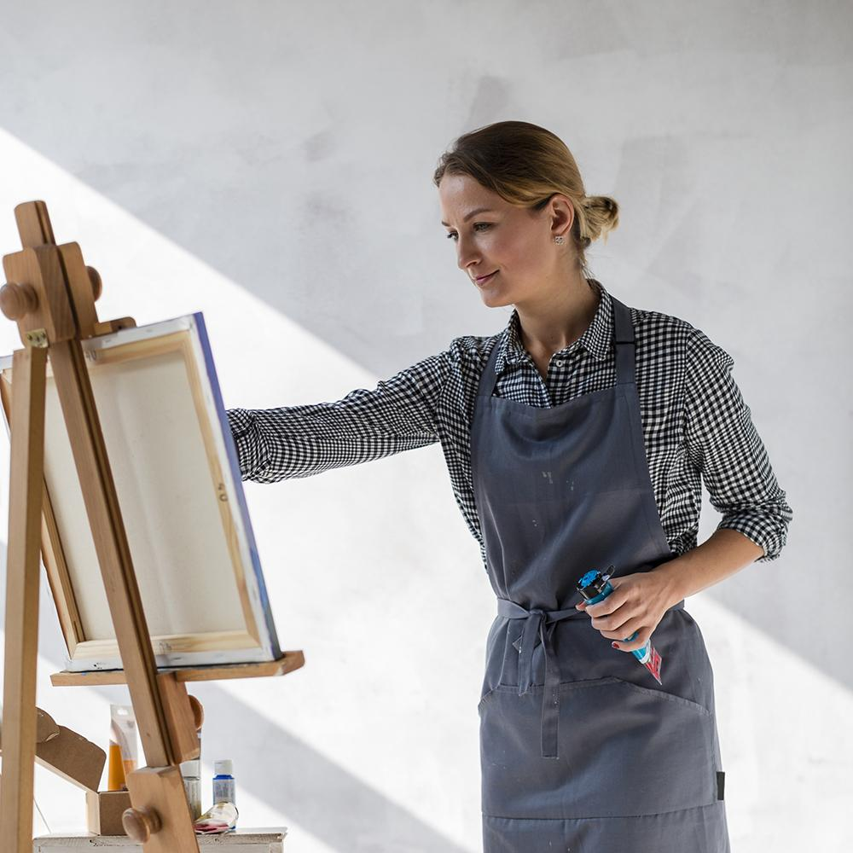
A Picture Always Reinforces the Concept
Images reveal large amounts of data, so remember: use an image instead of long texts

Slide 11
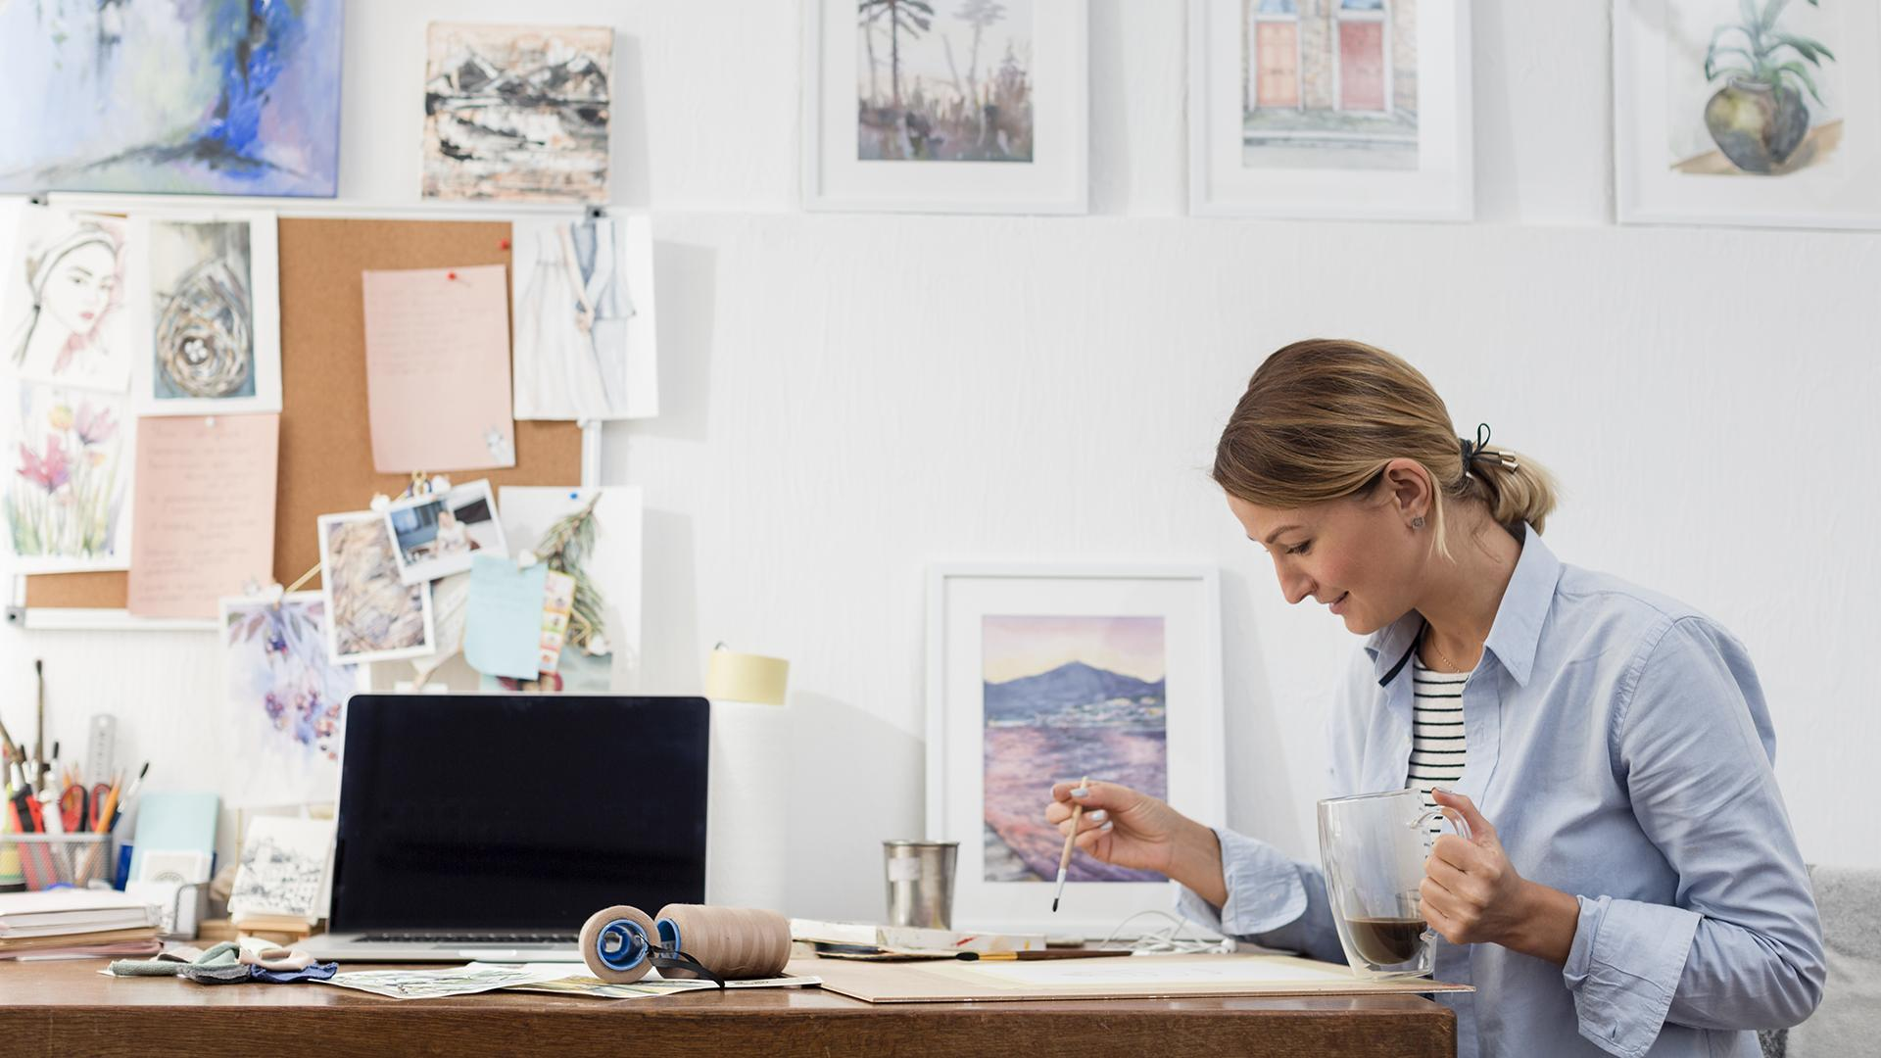
A Picture Is Worth a Thousand Words

Slide 12
Awesome Words
Because key words are great for catching your audience’s attention

Slide 13
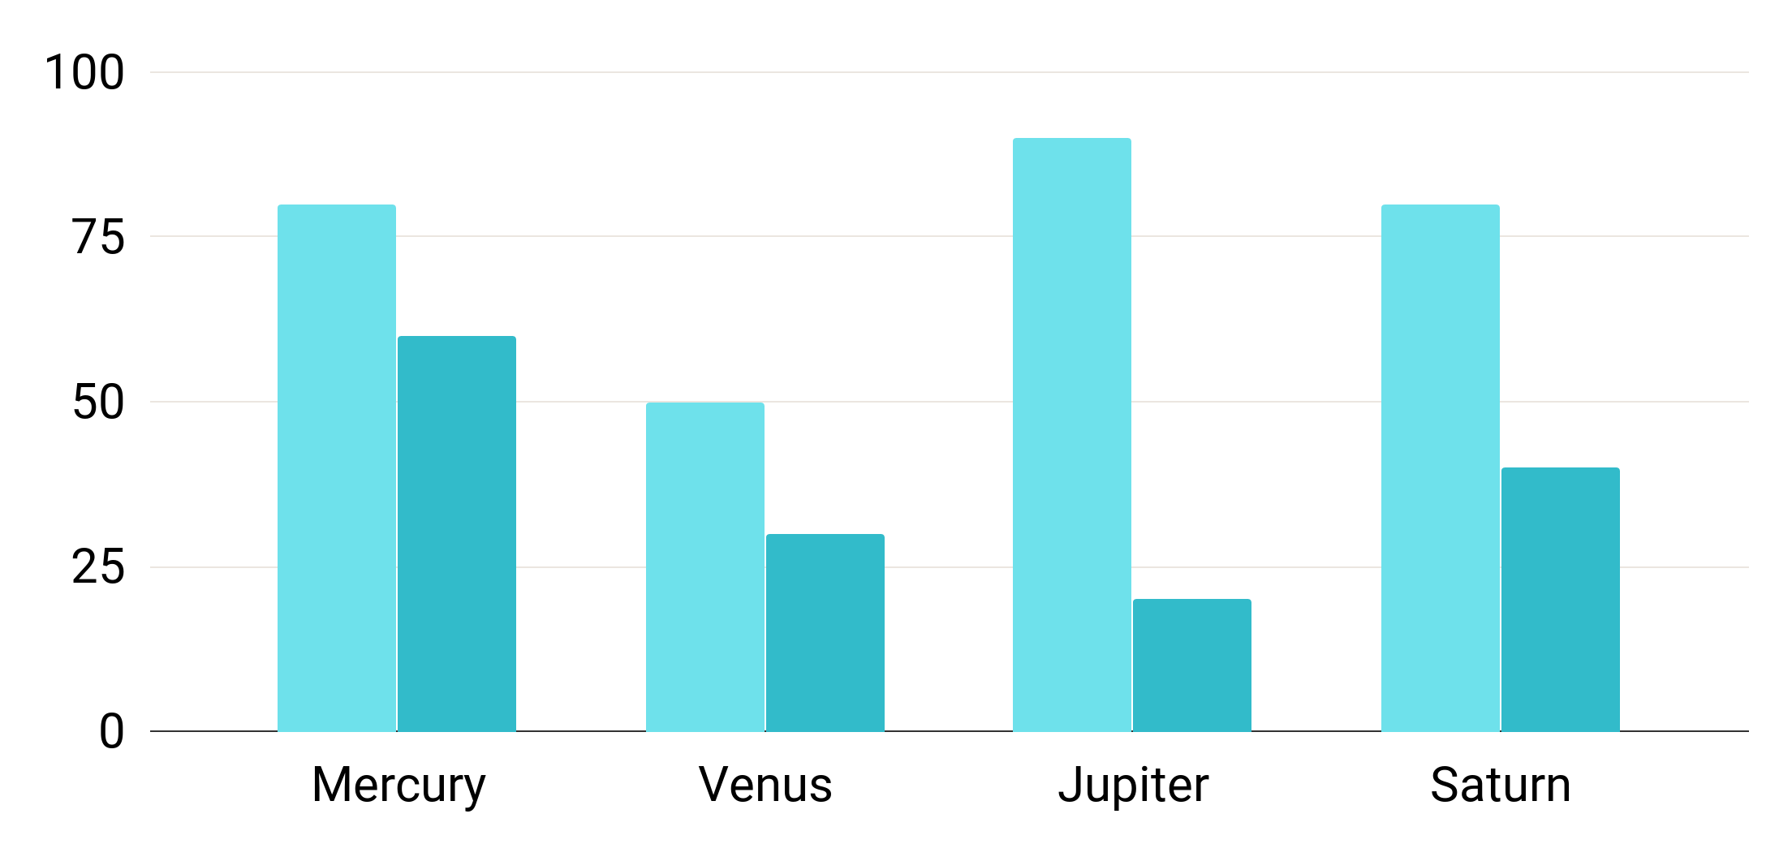
Use a Graph to Show Your Data
Mercury
Mercury is the closest planet to the Sun
Venus
Venus has a beautiful name, but terribly hot
To modify this graph, click on it, follow the link, change the data and paste the resulting graph here, replacing this one

Slide 14
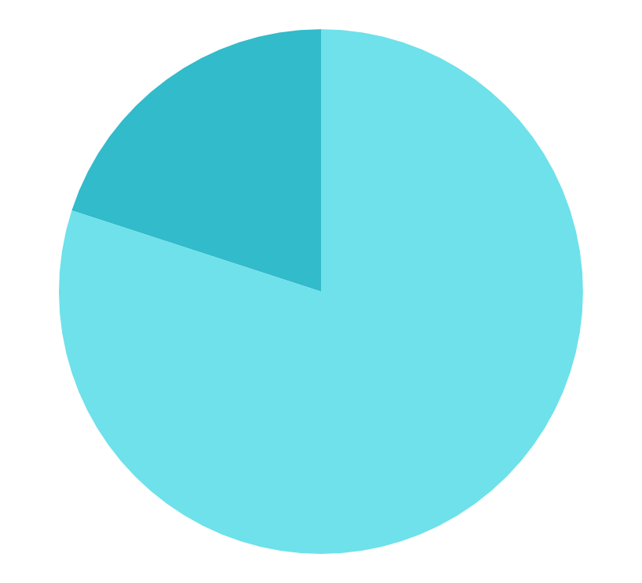
Use a Graph to Show Your Data
20%
Despite being red, it’s actually a cold place
80%
Mercury is the closest planet to the Sun
To modify this graph, click on it, follow the link, change the data and paste the resulting graph here

Slide 15
Sometimes, Reviewing Concepts Is a Good Idea
Mercury
Venus
Mars
Mercury is the closest planet to the Sun
Venus has a beautiful name, but it’s very hot
Despite being red, Mars is actually a cold place
Jupiter
Saturn
Neptune
It’s the biggest planet in the Solar System
Saturn is the ringed one and a gas giant
Neptune is the farthest planet from the Sun

Slide 16

How about Four Columns?
Mars
Mercury
Despite being red, Mars is actually a cold place full of iron oxide dust
Mercury is the closest planet to the Sun and the smallest in the Solar System
Jupiter
Venus
Jupiter is actually a gas giant and also the biggest planet in the Solar System
Venus has a beautiful name and is the second planet from the Sun

Slide 17
Or Three Columns?
01
02
03
Mars
Jupiter
Venus
Despite being red, Mars is actually a cold place full of iron oxide dust
Jupiter is actually a gas giant and also the biggest planet in the Solar System
Venus has a beautiful name and is the second planet from the Sun

Slide 18
Infographics Make Your Idea Understandable…
Mars
Saturn
Despite being red, Mars is a cold place
Saturn is the ringed one and a gas giant
Mercury
Venus
It’s the closest planet to the Sun
It has a beautiful name, but is very hot

Slide 19
02
Every Artist Was First an Amateur
You can enter a subtitle here if you need it

Slide 20
Explain Your Thoughts
Mars
Mercury
Despite being red, Mars is actually a cold place full of iron oxide dust
Mercury is the smallest planet in the entire Solar System
Jupiter
Venus
Jupiter is actually a gas giant and also the biggest planet in the Solar System
Venus has a beautiful name and is the second planet from the Sun

Slide 21
This Text Seems to Be Important...
Mercury is the closest planet to the Sun and the smallest one in the Solar System—it’s only a bit larger than the Moon

Slide 22
This Is a Table!
 | Mass | Diameter | Surface Gravity
Mercury | 0.06 | 0.38 | 0.38
Mars | 0.11 | 0.53 | 0.38
Saturn | 95.2 | 9.4 | 1.16

Slide 23
This is a Map
Saturn
Saturn is the ringed one and a gas giant
Mars
Despite being red, Mars is actually a cold place
Mercury
It’s the closest planet to the Sun

Slide 24
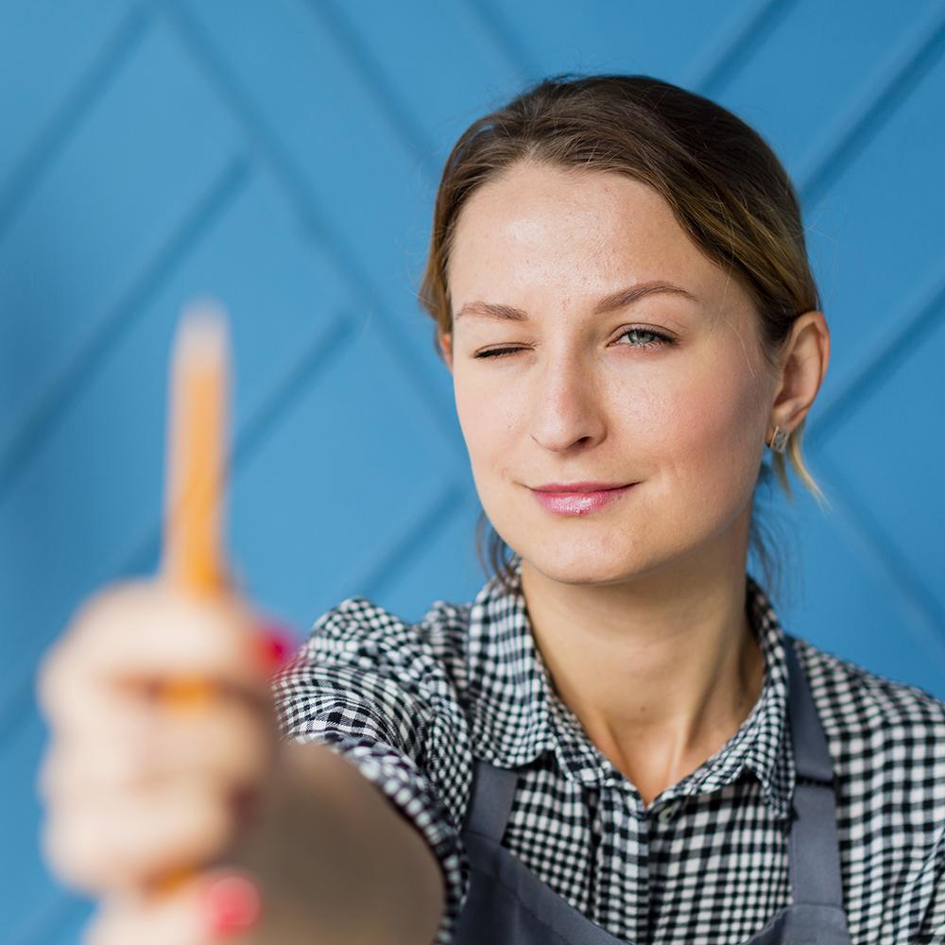

Find the True Artist in You
Artsy Anna
Brilliant Birdie
Here you could talk a bit about this person
Here you could talk a bit about this person

Slide 25
A Timeline Always Works Well
2015
2017
2020
2023
Mars
Mercury
Saturn
Venus
Despite being red, Mars is actually a cold place
Mercury is the closest planet to the Sun
Saturn is a gas giant and has several rings
Venus has a beautiful name, but is terribly hot

Slide 26
Try This Other Timeline
2015
Saturn
Saturn is the ringed one and a gas giant
2017
Mars
Despite being red, Mars is a cold place
2020
Mercury
It’s the closest planet to the Sun

Slide 27

7,498,300
Big numbers catch your audience’s attention

Slide 28
Here Are Some Percentages
37%
59%
85%
Mars
Mercury
Saturn
Despite being red, Mars is actually a cold place
Mercury is the closest planet to the Sun
Saturn is the ringed one and it’s a gas giant

Slide 29
386,000 km
333,000.00
24h 37m 23s
is the distance from Earth and the Moon
earths is the mass of the Sun
is the total of Jupiter’s rotation period

Slide 30
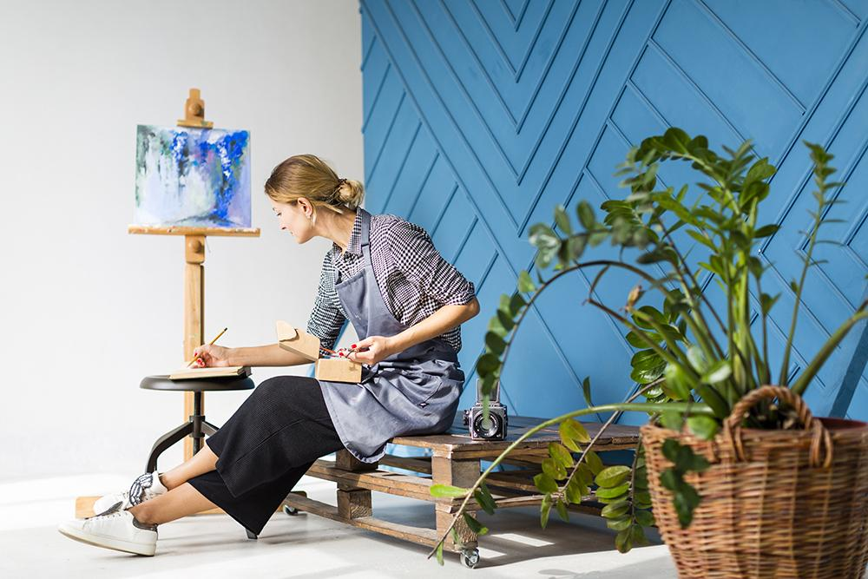
Desktop Software
You can replace the image on the screen with your own work. Just delete this one, add yours and center it properly

Slide 31
Tablet App
You can replace the image on the screen with your own work. Just delete this one, add yours and center it properly

Slide 32
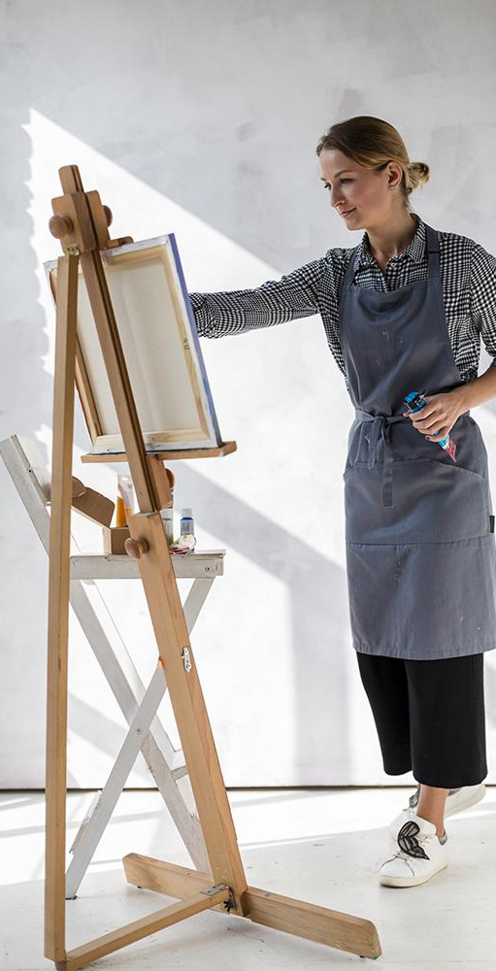
Mobile Web
Mars
Despite being red, Mars is actually a cold place
Mercury
You can replace the image with your own work. Delete this one, add yours and center it properly
It’s the closest planet to the Sun
Saturn
Saturn is the ringed one and a gas giant

Slide 33
Thank You!
Do you have any questions?
youremail@freepik.com
+91 620 421 838
yourcompany.com
Please keep this slide for attribution.

Slide 34
Alternative Resources
Here’s an assortment of alternative resources within the same style of this template
Vectors
Watercolor stain collection
Blue watercolor stains collection
Watercolour copy space background gradient blue
Photos
Woman on desk with supplies
Side view of artist working at desk
Young artist hand painting in the nature
Artist working on painting in apron

Slide 35
Resources
Did you like the resources on this template? Get them for free at our other websites.
Vectors
Realistic watercolor trace collection
Photos
Medium shot of creative woman painting
Female artist painting in apron
Woman painting outdoors
Portrait of young woman holding a pencil

Slide 36
Instructions for use
In order to use this template, you must credit Slidesgo by keeping the Thanks slide.
You are allowed to:
- Modify this template.
- Use it for both personal and commercial projects.
You are not allowed to:
- Sublicense, sell or rent any of Slidesgo Content (or a modified version of Slidesgo Content).
- Distribute Slidesgo Content unless it has been expressly authorized by Slidesgo.
- Include Slidesgo Content in an online or offline database or file.
- Offer Slidesgo templates (or modified versions of Slidesgo templates) for download.
- Acquire the copyright of Slidesgo Content.
For more information about editing slides, please read our FAQs or visit Slidesgo School:
https://slidesgo.com/faqs and https://slidesgo.com/slidesgo-school

Slide 37
Fonts & colors used
This presentation has been made using the following fonts:
Red Hat Display
(https://fonts.google.com/specimen/Red+Hat+Display)
#6ee1eb
#32bbca
#298dbf
#000000

Slide 38
Stories by Freepik
Create your Story with our illustrated concepts. Choose the style you like the most, edit its colors, pick the background and layers you want to show and bring them to life with the animator panel! It will boost your presentation. Check out How it Works.
Pana
Amico
Bro
Rafiki

Slide 39
Use our editable graphic resources...
You can easily resize these resources without losing quality. To change the color, just ungroup the resource and click on the object you want to change. Then, click on the paint bucket and select the color you want. Group the resource again when you’re done. You can also look for more infographics on Slidesgo.

Slide 42
JANUARY
FEBRUARY
MARCH
APRIL
MAY
JUNE
PHASE 1
Task 1
Task 2
PHASE 2
Task 1
Task 2
JANUARY
FEBRUARY
MARCH
APRIL
PHASE 1
Task 1
Task 2

Slide 45
...and our sets of editable icons
You can resize these icons without losing quality.
You can change the stroke and fill color; just select the icon and click on the paint bucket/pen.
In Google Slides, you can also use Flaticon’s extension, allowing you to customize and add even more icons.

Slide 46
Educational Icons
Medical Icons

Slide 47
Business Icons
Teamwork Icons

Slide 48
Help & Support Icons
Avatar Icons

Slide 49
Creative Process Icons
Performing Arts Icons

Slide 50
Nature Icons

Slide 51
SEO & Marketing Icons

Slide 52


